Slide 1
Predictis
CSE - 306
MPMC Sessional
A Medical Decision Making Daignosis System

Slide 2
Predictis
Prepared By :
1 Asima Oshin Putul 201814048
Kazi Rafid Raiyan 201814022
M M Rushadul Mannan 201814056
4 Fardeen Ashraf 201814046
A Medical Decision Making Daignosis System

Slide 3
Project
Smart White Kane
A Medical Decision Making Daignosis System

Slide 4
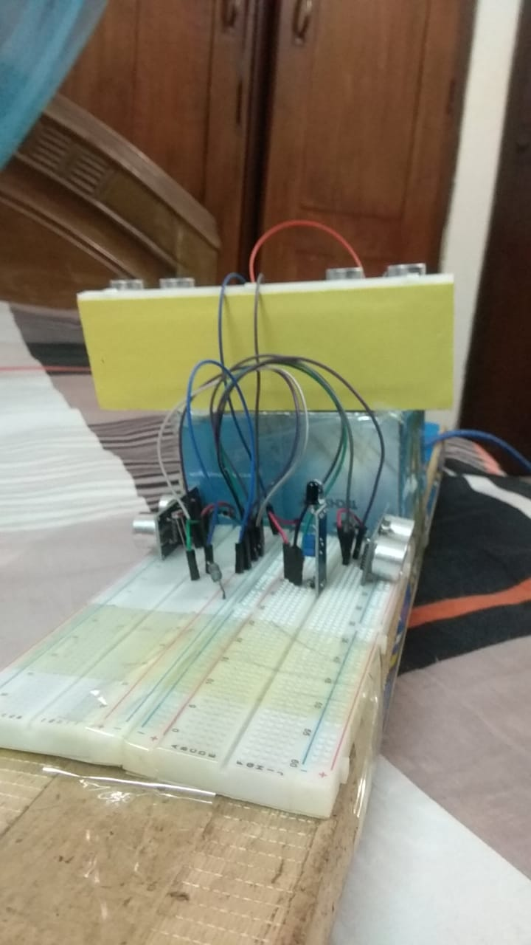
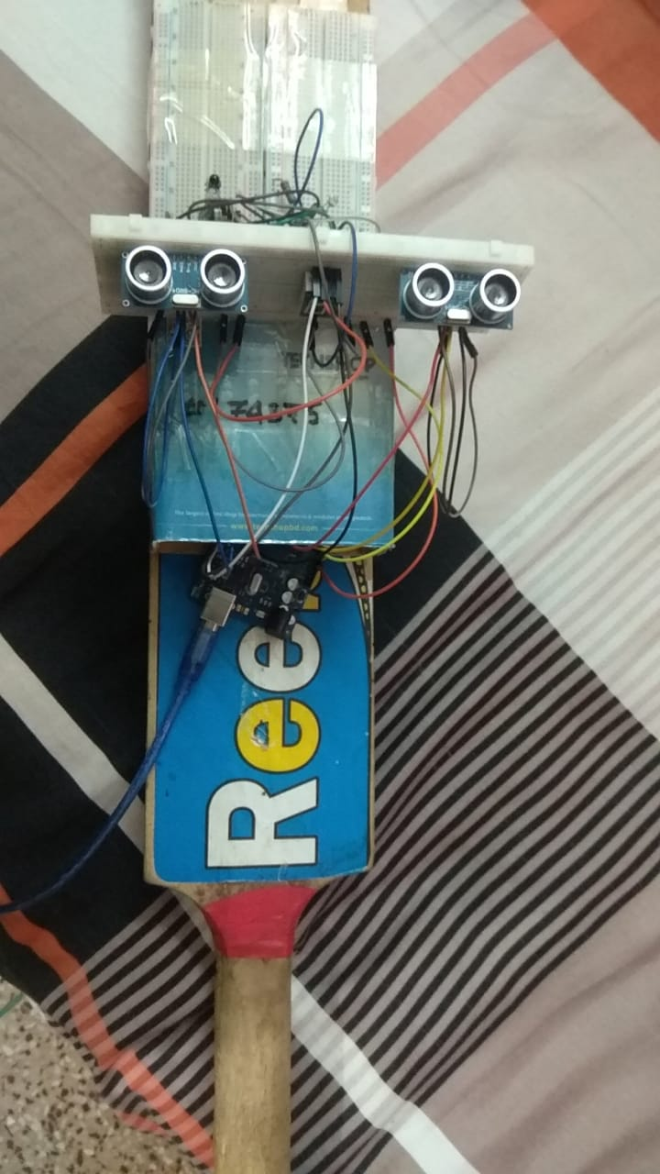
A Medical Decision Making Daignosis System

Slide 5
Predictis
Project Proposal
A Ultrasonic blind walking stick using Arduino Mega was proposed. This will Enable a blind person to know if there is any obstacle, probable collusion with others and manholes while walking in roads. Using this smart stick a blind person can also know if it’s daytime or night. Also using this smart stick a blind person can know where the stick is remotely. Using this stick a blind person can also notify their close acquaintances if they are in trouble.
A Medical Decision Making Daignosis System

Slide 6
Predictis
Covered Topics
Object Detection and Light Intensity
Location and Navigation
Remote Messaging
Remote Control
A Medical Decision Making Daignosis System

Slide 7
Complete Design
A Medical Decision Making Daignosis System

Slide 8
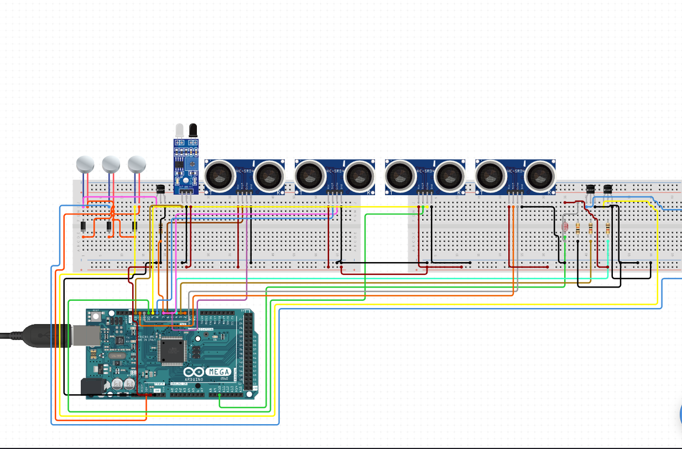

Predictis
Object Detection and LDR Design
A Medical Decision Making Daignosis System

Slide 9
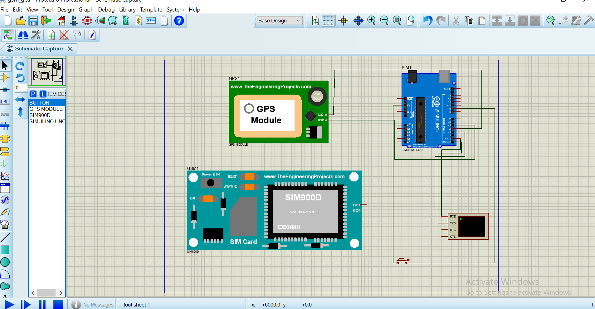
Predictis
Location and Remote Messaging Design
A Medical Decision Making Daignosis System

Slide 10
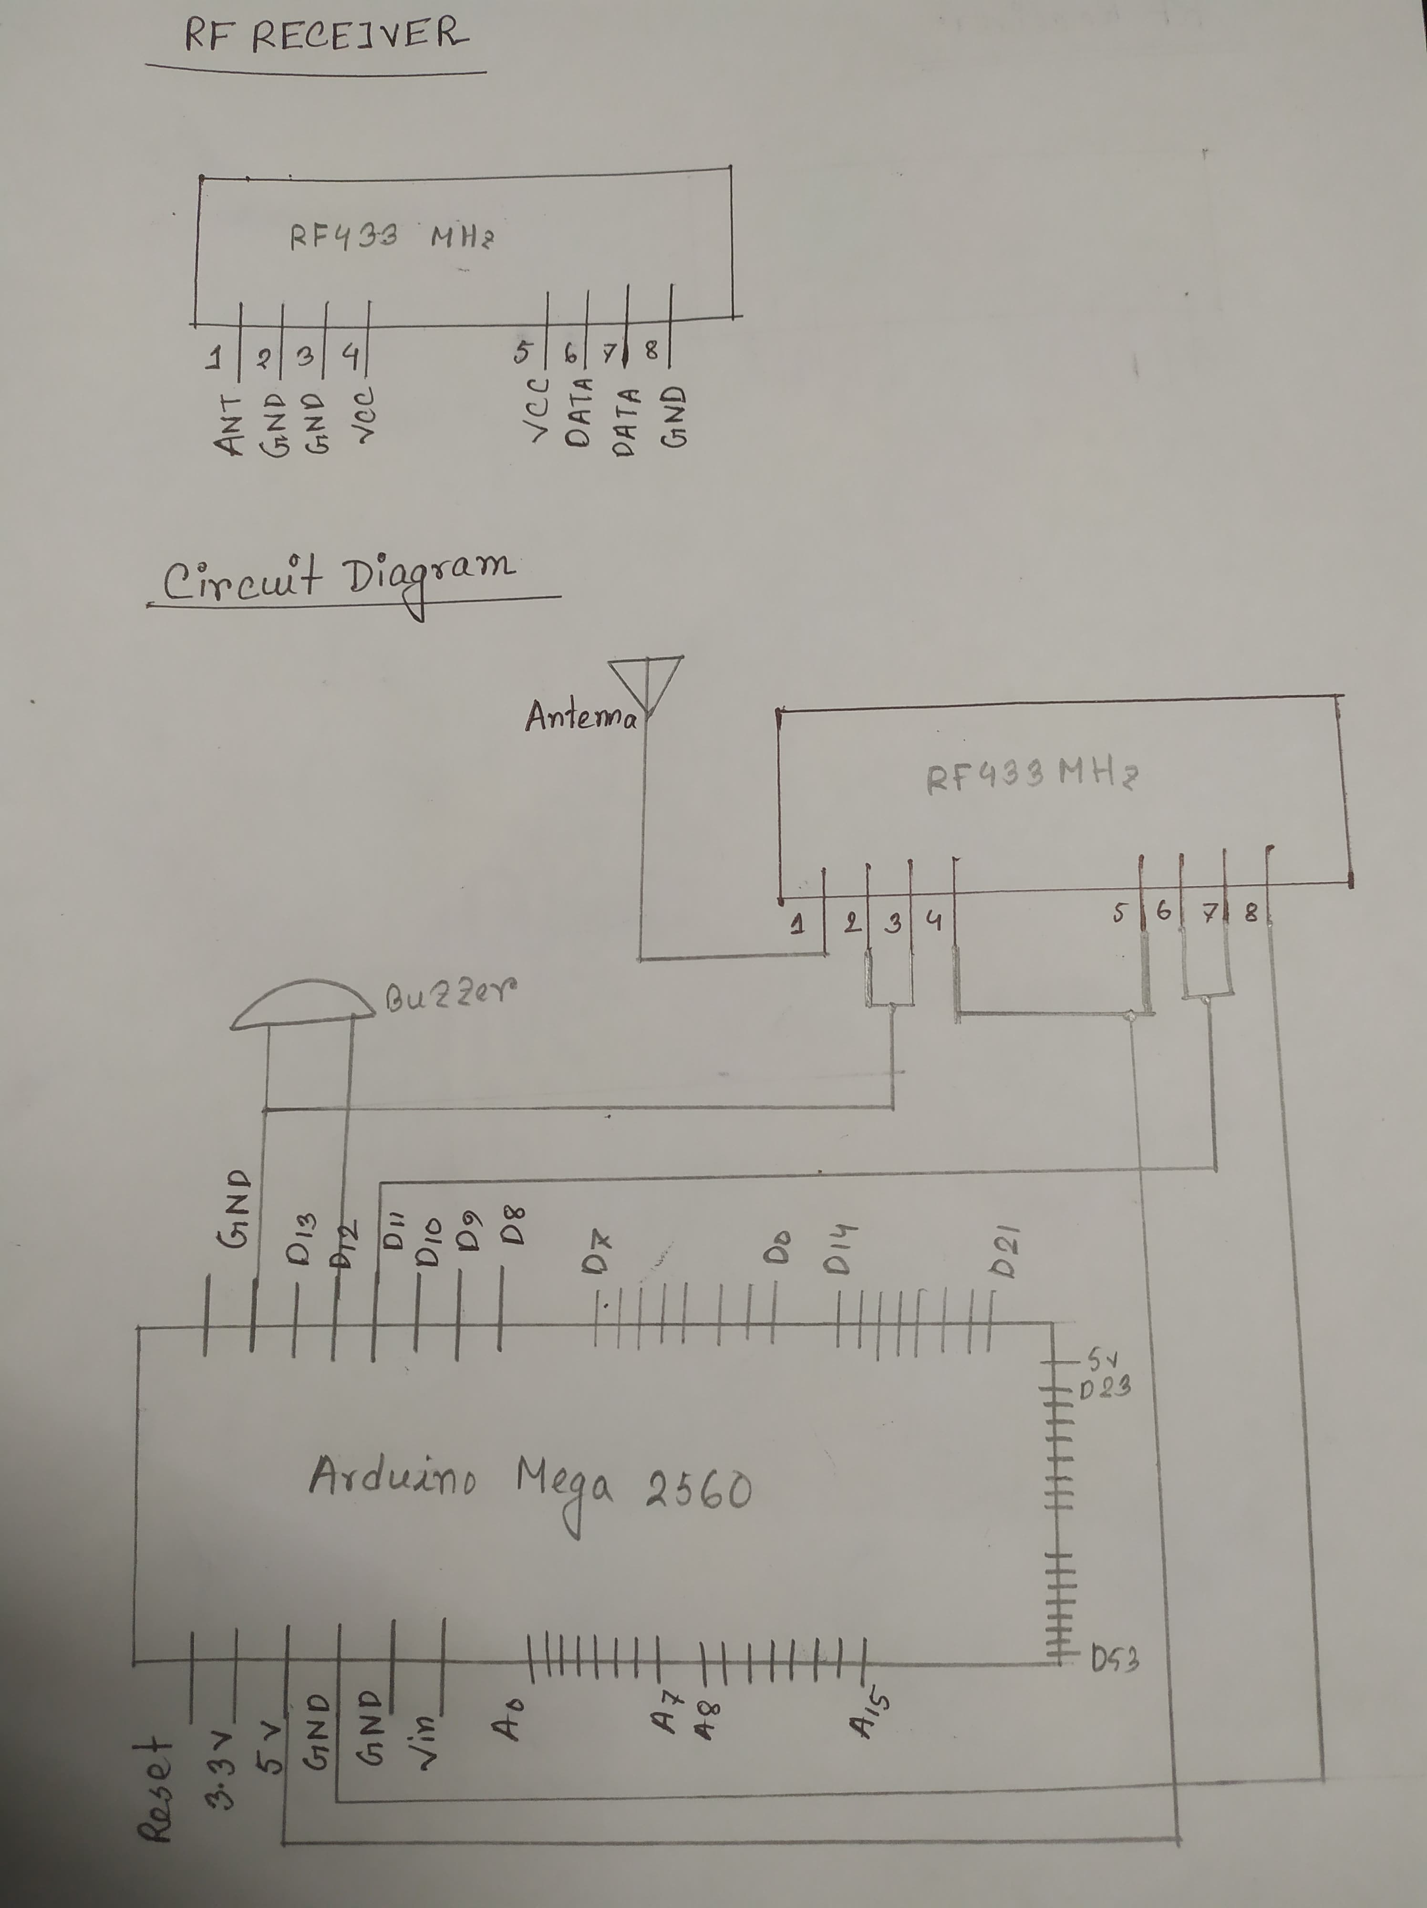
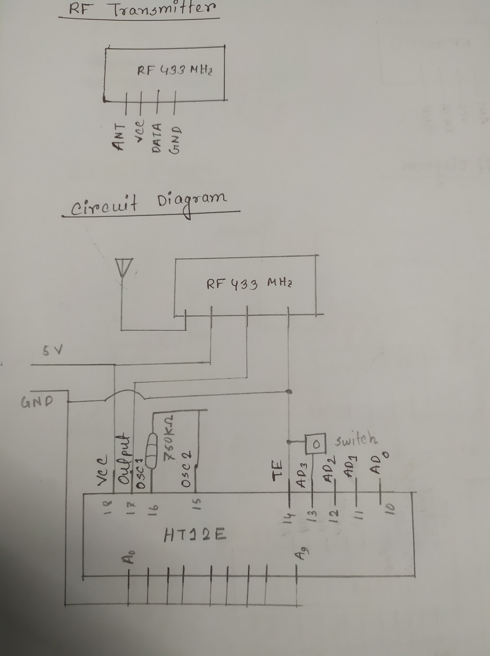
Predictis
Rf Transmitter Receiver Design
A Medical Decision Making Daignosis System

Slide 11
Implementation
A Medical Decision Making Daignosis System

Slide 12
Predictis
Object Detection and LDR Design
A Medical Decision Making Daignosis System

Slide 13
Predictis
Object Detection and Light Intensity
For the purpose of object detection Ultrasonic Sensor - HC-SR04 and IR Obstacle Avoidance sensors were used. The main reason for using two types of detection sensors is to detect obstacle in multiple ranges from the smart stick. Ultrasonic Sensor - HC-SR04 is mainly used to detect obstacle from low to mid ranges as these sensors have a range of 2cm to 400cm with an accuracy of 3mm. These sensors will be fitted on to lower and mid part of the stick. The sensors while turned on keep taking readings of any object that is in their line of sight and send the reading to Arduino Mega 2560.
A Medical Decision Making Daignosis System

Slide 14
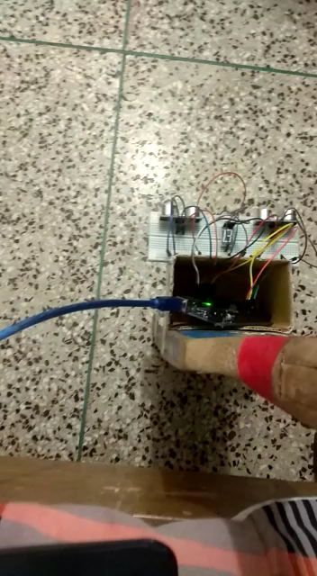
Predictis
Visual Representation
A Medical Decision Making Daignosis System

Slide 15
Predictis
Location and Remote Messaging Design
A Medical Decision Making Daignosis System

Slide 16
Predictis
Location and Navigation
GPS modules contain tiny processors and antennas that directly receive data sent by satellites through dedicated RF frequencies. From there, it’ll receive timestamp from each visible satellites, along with other pieces of data. If the module’s antenna can spot 4 or more satellites, it’s able to accurately calculate its position and time.
A Medical Decision Making Daignosis System

Slide 17
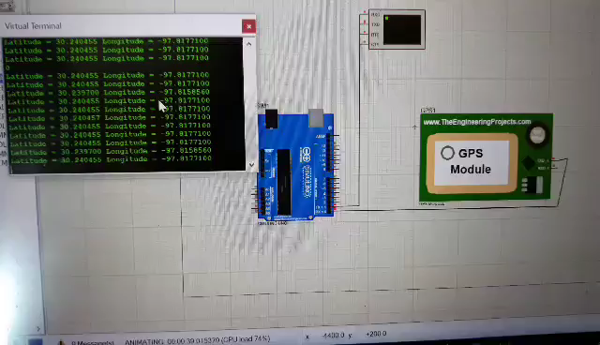
Predictis
Visual Representation
A Medical Decision Making Daignosis System

Slide 18
Predictis
Remote Messaging
When the GSM modem receives a message, the microcontroller will process the message with the keyword Saved in it. Then, it will get the location of the stick from the GPS modem and transmit the location to the GSM modem in order to respond to the sender. In case of an emergency, the user of the stick can press the emergency button the microcontroller accesses the location from the GPS modem and transmit the location to the GSM modem which will send a SMS messages to the saved number in the system.
A Medical Decision Making Daignosis System

Slide 19
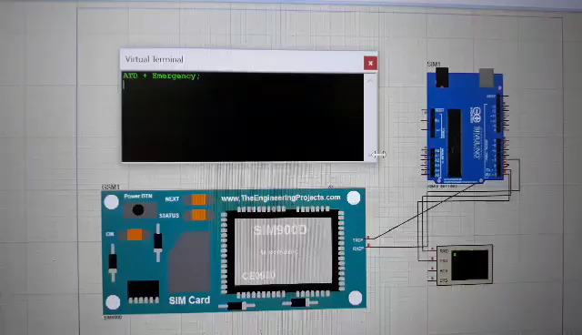
Predictis
Visual Representation
A Medical Decision Making Daignosis System

Slide 20
Predictis
Remote Control
An RF module (radio-frequency module) is a small electronic device used to transmit and receive radio signals between two devices. In an embedded system it is often desirable to communicate with another device wirelessly. RF module operates at Radio Frequency. This frequency range varies between 30 kHz & 300 GHz. In this RF system, the digital data is represented as variations in the amplitude of carrier wave. This RF module is a combination of RF Transmitter and RF Receiver. The transmitter/receiver (Tx/Rx) pair operates at a frequency of 433 MHz. The RF transmitter receives serial data and transmits it wirelessly through through its RF antenna. The transmission occurs at the rate of 1 Kbps – 10 Kbps. RF receiver receives the transmitted data and it is operating at the same frequency as that of the transmitter.
A Medical Decision Making Daignosis System

Slide 21
Predictis
Rf Transmitter Receiver Design
A Medical Decision Making Daignosis System

